Slide 1




Standards Round Table
Bob Cornacchioli
get2bobc@gmail.com
http://www.derotechnical.com

Slide 2





CEO - DERO Technical Services (2007)
Marketing/- ParkBench Software Trainer (2007)
Evangelist/Process Lead- Level Data (2010)
PSISJS Partner – Standards/Trainer (2013)
Alpha/Beta Team for PS and PTP
Bob Cornacchioli
Director of Technology and Media Services
Shrewsbury Public Schools (16 yrs.)
PowerSchool Administrator (6 yrs.)

Slide 3
Who are you?
Traditional or Standards Grades?
  Teachers have graded
  Teachers will be grading
  Selection Process?
  Special Needs/GIFTED/ELL Students
  Gradebook 2.8 or PowerTeacherPro
  Start Date- This year?
  Hybrid Anyone?
Common Core?
Going/Gone to PS19

Slide 4
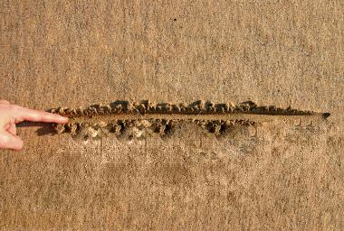
CURRICULUM/ADMIN & TECHNICAL
DRAW A LINE IN THE SAND
Collaborate and learn the constraints

Slide 5


This is your Agenda!
Lots of Standards Resources can be found @
www.derotechnical.com

Slide 6

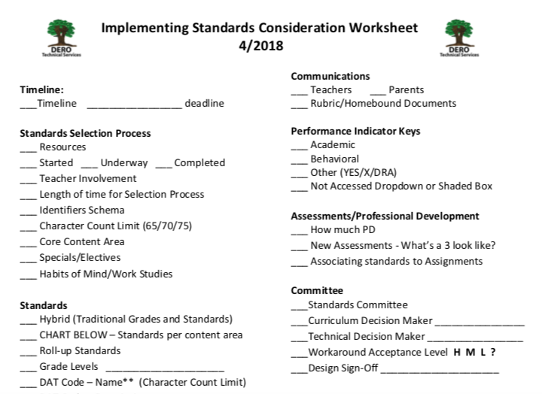
Standards Worksheet http://www.derotechnical.com/STANDARDS

Slide 7

Austin’s Butterfly
JUMPSTART or RE-IGNITE
YOUR STANDARDS
INITIATIVE
Featuring Ron Berger from Expeditionary Learning.
Produced by David Grant (www.elschools.org)

Slide 8
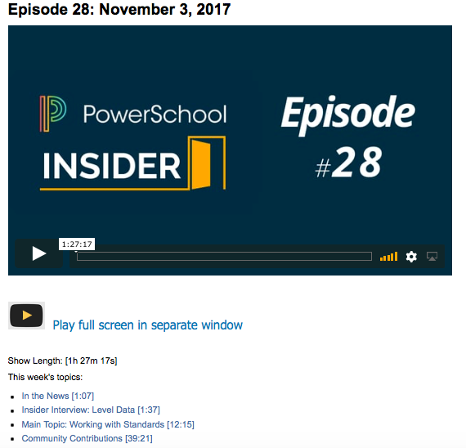
25 MINS
All ABOUT
STANDARDS!

Slide 9

SELECTION
PROCESS and TIMELINE
WHO
RESOURCES
CORE & SPECIALS
PROFESSIONAL
DEVELOPMENT
BENCHMARKS

Slide 10

Do you recall?
Transitioning from ABC to 4321 or OSUN
Designing
Report Card
Curriculum Review
NEW Assessments
SPECIAL NEEDS
GIFTED
Grading Best
Practices
Comment
Narrative/Bank
Gradebook
Training
DATA ANALYSIS
Evaluation Student
Work Samples
TRANSITION TIME
12-24 months
Assignments/
Final Entry
ON-GOING PD
Communication
Plan
Professional
Judgement
Performance
Indicators
Standards
Selection
Paradigm
Shift PD
Why
Standards

Slide 11
REVIEW #’S OF SELECTED STANDARDS
 | PreK | K | 1 | 2 | 3 | 4 | 5
ELA | 15 | 12 | 18 | 10 | 17 | 23 | 32
MA | 12 | 6 | 12 | 13 | 13 | 14 | 14
SCI | 2 | 2 | 3 | 14 | 3 | 3 | 4
How many are too few!
How many are too many!

Slide 12
Change requires continual checking of your stakeholders temperature.
HAS THIS HAPPENED YET?
Parents
Teachers
Tech Team

Slide 13


SHIFT Communication Plan
Communication Plan may include but not limited to…
MULTIPLE PARENTS NIGHTS
WEB PRESENCES
ROBO-CALL JUST FOR STANDARD MIGRATION
WHEN AGE APPROPRIATE … USE YOUR STUDENTS
4
Niall
GRADE 8-12 MATH TEACHER
Tara
GRADE 8-12 ENGLISH TEACHER
O

Slide 14
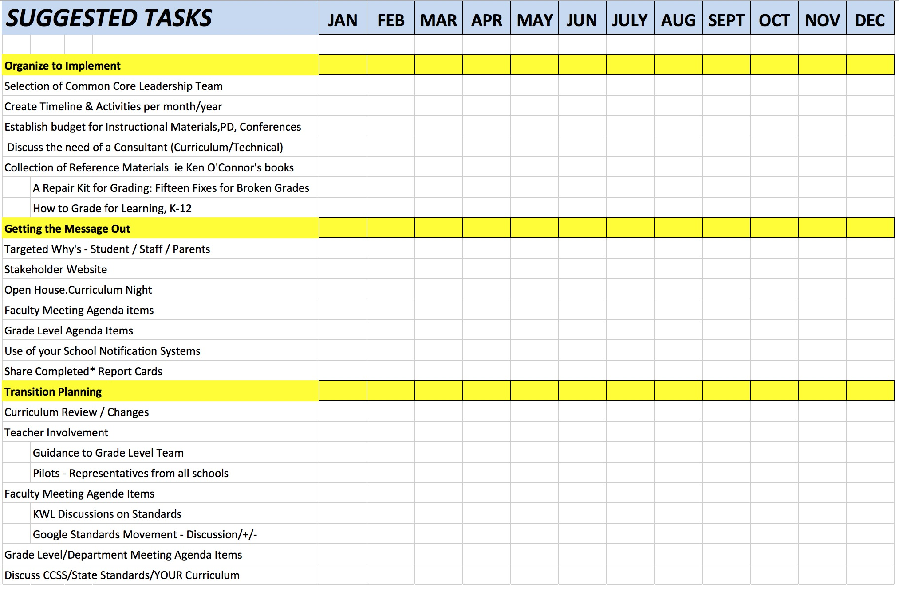
Suggested Tasks and Benchmarks
SAMPLE
http://www.derotechnical.com/STANDARDS/Standards.html

Slide 15
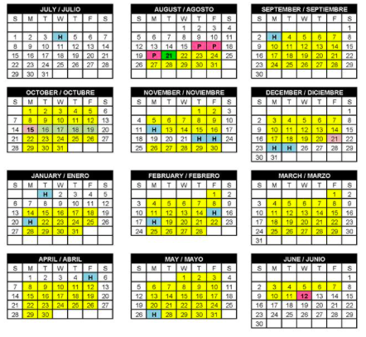
Professional Development Plan
What have you done?
One and Done
Relationship between PD and Increased Use
Getting Started Scoring vs Data Analysis
When is your next PD/Faculty Meeting?
They don’t know what they don’t know…
EXACT TIMES = COMMITMENT
Grade Level Meetings
Faculty/Departmental Meetings
PD Days and Times

Slide 16
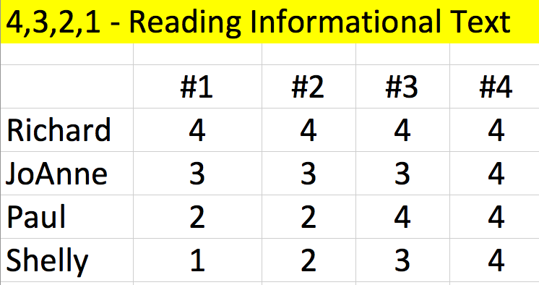
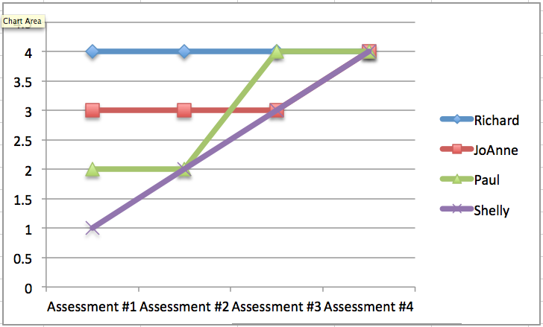

ON-GOING PROFESSIONAL DEVELOPMENT!
Fix #14 – Tendency vs Average
The most recent
score for all
is a 4!
If at first you don’t succeed,
skydiving may not be for you!
Tendency
Trends
Average
Mastery

Slide 17

Homebound Assessment
C
Avoid Confusion- Adjust Rubrics and assessments
Sending Home Letter Grades and Percentages will confuse Parents and Students
How does an
A-, B+, 93, 82, B-
EQUAL a 3?

Slide 18
Definition of Wordsmith
A person who works with words; especially a skillful writer.
Some state and common core standards are well over 400 characters in length.. the NAME of a standards must be shortened.
It’s extraordinarily difficult to shorten standards that a committee has worked to select, finding additional time to now shorten them!
Wordsmithing Services are on the rise!
DO YOUR PARENTS UNDERSTAND YOUR STANDARDS?

Slide 19
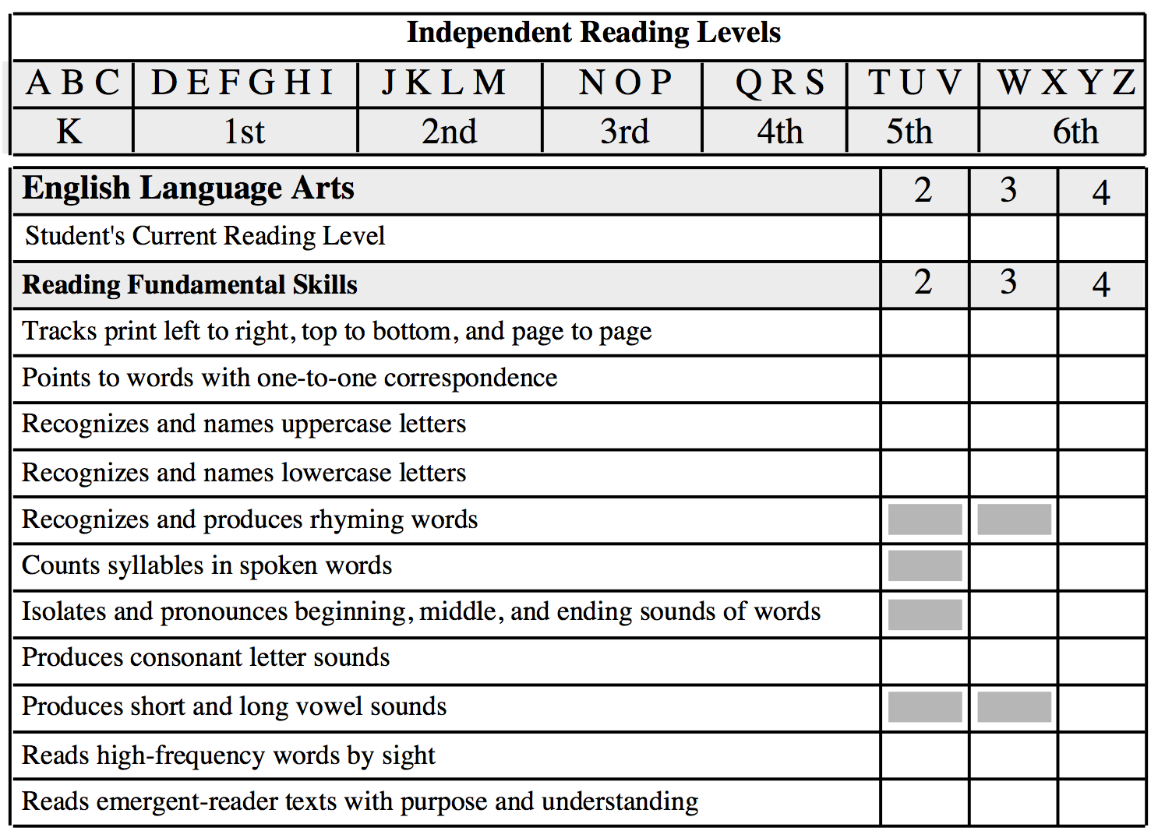
O
U
O
O
O
Wisconsin Parent...
Now that I know what standard my daughter is struggling with, I hope I can understand what the standard means?
S
O
O

Slide 20
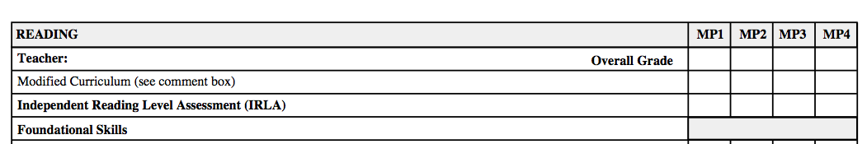
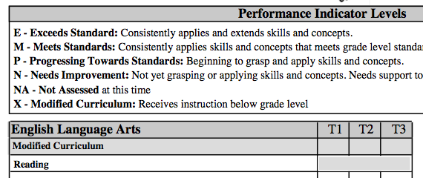
DELIMMA
Special Needs Students
HOW

Slide 21
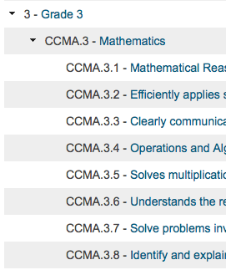
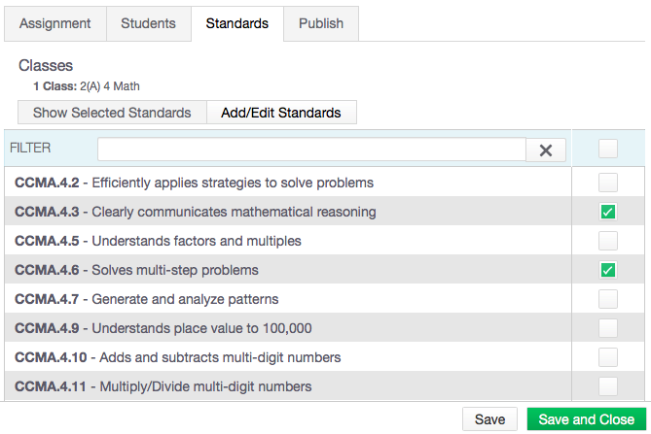
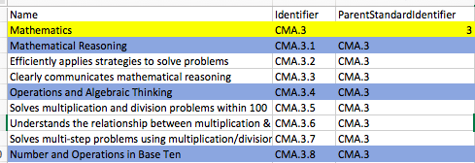
Power of the ListParentIdentifier
ListParentIdentifier – places “child” standards under their parents

Slide 22
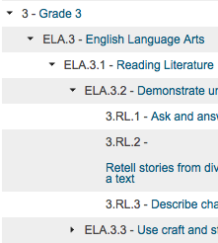
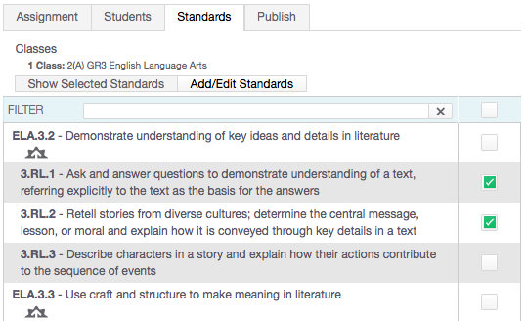
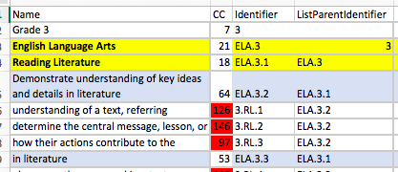
ListParentIdentifier - Rollup
ListParentIdentifier – places “child” standards under their parents

Slide 23
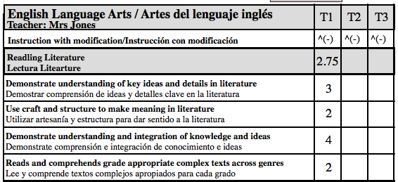
Why Calculating Higher Level Standards Doesn’t Always Work for Teachers
10
2
1
3
Depending Upon Your Scale Cut-off/Grade Values does 2.75 become a 2 or a 3?
Does each lower level standard contribute 25% of the Reading Literature Grade?

Slide 24
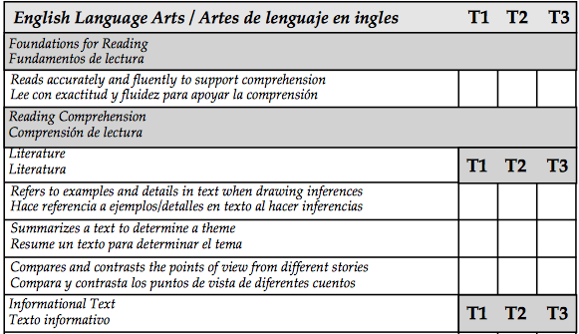
What to show in the PTP?
CELA.4.2
CELA.4.3
CELA.4.4
CELA.4.5
CELA.4.6
CELA.4.7
CELA.4.8
CELA.4.9

Slide 25
Available Standards Resources on www.derotechnical.com
Implementing Standards Retiring Standards
PTG and Standards PTP and Standards
Standard Analytics PTP Round Table
Changing Standards Grade & Conversion Scales
Suggested Tasks Keys to Implementing
Navigational Difference Between PTG and PTP
FREE – Standards Related Reports
Standards Implementation Checklist
Character Count Excel Downloads
And MORE!

Slide 26

Standards Grade Rollup Settings Talking Points
START
OF TERM
MIDDLE
OF TERM
END
OF TERM
SENDING TEACHER EXCLUDING
STANDARD SECTION GRADES ALREADY SCORED
EXCLUDING GRADES FROM DROPPED CLASSES
RECEIVING TEACHER – LOTS OF WORK AT END OF TERM
WHICH TEACHERS GRADES COUNT MORE
AVERAGE STANDARD GRADES
SCORED TWICE IN THE SAME TERM

Slide 27
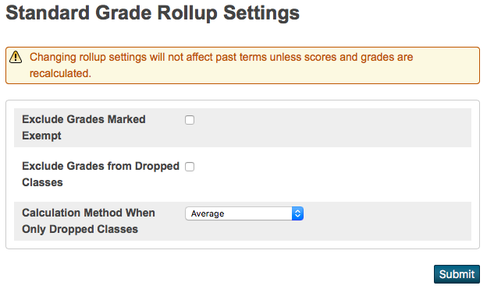
Once on PS 12.0.X
√
If checked, any grades a teacher marked exempt are not included in the standard grade rollup.
√
If checked, any grades from classes the student has dropped will not be included in the standard grade rollup unless there are no active grades. In the case of no active grades, grades from dropped classes are included.
When there are grades only from dropped classes, the district has the option to report the average of all dropped grades, or just the grade from the most recently enrolled class. Use the Calculation Method When Only Dropped Classes menu to choose whether to average the grades or to use Most Recent Enrolled only the last grade.

Slide 28
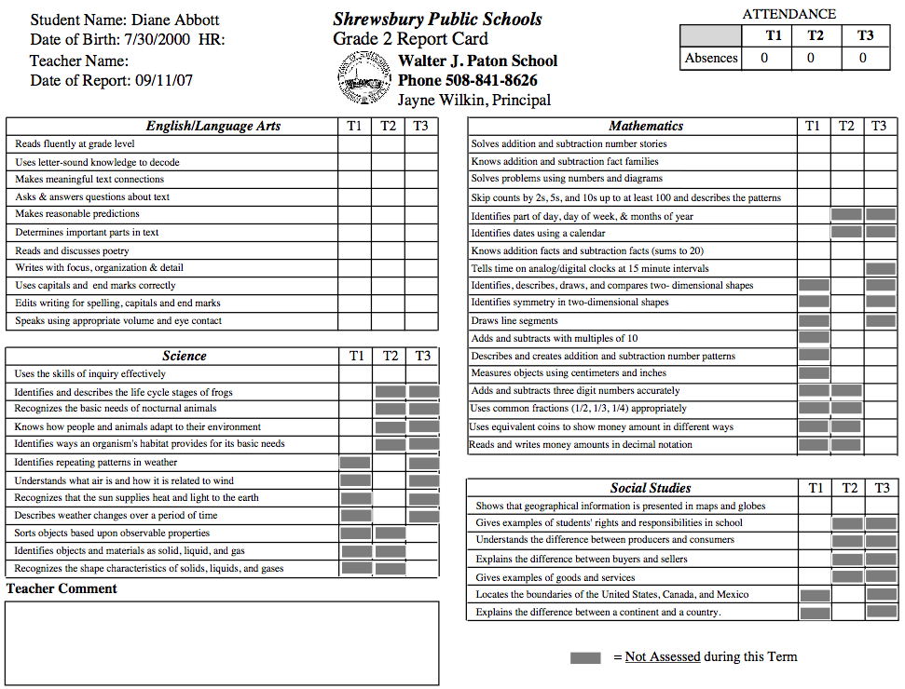




Have you thought about Report Cards?
CT
Parent Portal – access to grades – list form
NOT DYNAMIC – all must be custom made
Object Reports vs. Online
  ParkBench Visual PST (ME)
  Computer Group Logic (HERE)
  PSISJS.COM (ME)
  MBA Report Card Creator (HERE)
Summative
Multi-page requires duplex printer
http://www.derotechnical.com/REPORTCARDS/REPORTCARDS.html

Slide 29

CURRICULUM LEADERSHIP
TECHNICAL TEAM or YOU
Develop Process and Timeline
Establish a team (WITH TECH FOLKS)
Discuss PILOTS for District
Gather Resources
Create Grade Level Teams/Leaders
Plan STAKEHOLDER communications
Review Curriculum and Assessments
Establish/Create the Rubrics/Scales
Discuss Special Ed, GIFTED, ELL Students
Word smith for understanding & shorten
Draft list of STANDARDS in EXCEL not WORD
ELA-MA-Work Habits-SCI-SOC- Specials
Cherry Pick BETTER standards
Review samples of SB report cards
Decided Printable/Online report cards
Word smith for understanding & shorten
Provide FINAL excel to Tech Team
Plan adequate PD for Gradebook Training
Set Faculty/Grade Level Sharing Expectations
Attend Standards Meetings
Review Course Numbers (at each school)
Create Grade Scales once provided
Understand columns standard import files Build Standard Import Template
Send it to BobC – Reviews for FREE
WHEN FINAL – Import (opt- no primary)
Research Object Reports or Online Options
Create or contract for report card
Create a single grade to PERFECTION
Bring Constraints to Curriculum Team
SIGN-OFF on designed report card
Learn Gradebook even if you aren’t training
Create all report cards/import
Find your early graders!!
ADEQUATE TIME
STANDARD SELECTION PROCESS
REFLECTION
ASSESSMENT/GRADING CHANGES
PROFESSIONAL DEVELOPMENT
CREATION OF THE SBRC
Skipping these steps will result in continuous revisions and most
often FAILURE!

Slide 30
ANY AND ALL DERO RESOURCES ARE AVAILABLE
TO DOWNLOAD, TWEAK and USE FOR YOUR DISTRICT!
Q & A
Bob Cornacchioli
get2bobc@gmail.com
www.derotechnical.com

